Slide 1
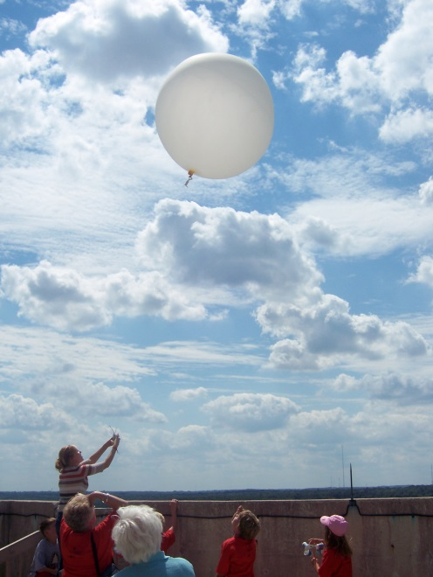
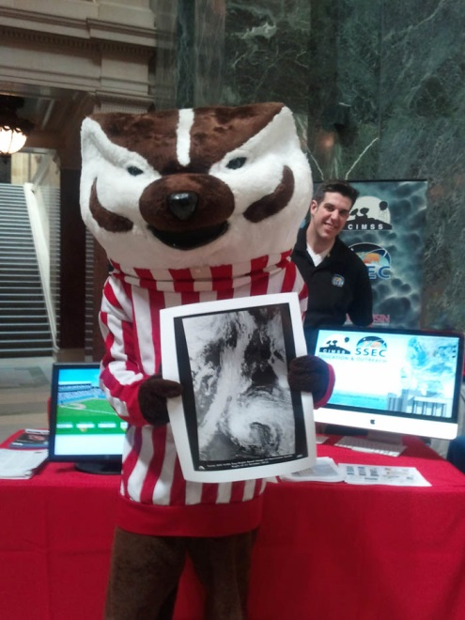
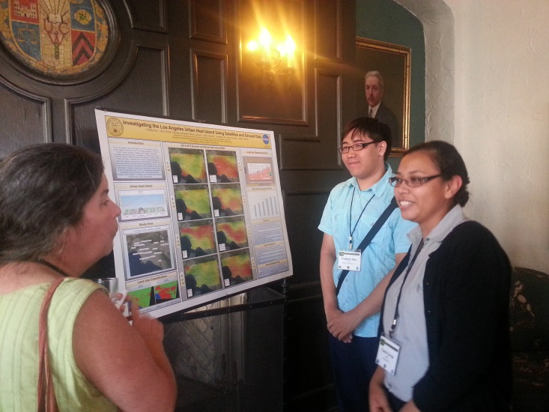
Sharing Remote Sensing Science with Society - Education and Outreach Opportunities for Graduate Students
Margaret Mooney
Cooperative Institute for Meteorological Satellite Studies (CIMSS)
Space Science and Engineering Center (SSEC)
University of Wisconsin-Madison
Notes:
Conducting science is important, but sharing science is essential. Outreach initiatives to share science with society at CIMSS include volunteering at Science on a Sphere exhibits, forecasting for football games, contributing to weather blogs and presenting at education conferences. This talk will profile several graduate student contributions to CIMSS Education and Public Outreach initiatives as well as opportunities for future collaborations.

Slide 2
About CIMSS Cooperative Institute for Meteorological Satellite Studies
CIMSS is a Cooperative Institute between the University of Wisconsin-Madison and NOAA
CIMSS operates within the UW-Madison Space Science and Engineering Center (SSEC)
CIMSS & SSEC are renown for satellite remote
sensing research and imagery.
Scientists from NOAA NESDIS Advanced Satellite
Products Branch (ASPB) are co-located at CIMSS
CIMSS Education and Outreach efforts
prioritizes weather and climate literacy
http://cimss.ssec.wisc.edu/education

Slide 3
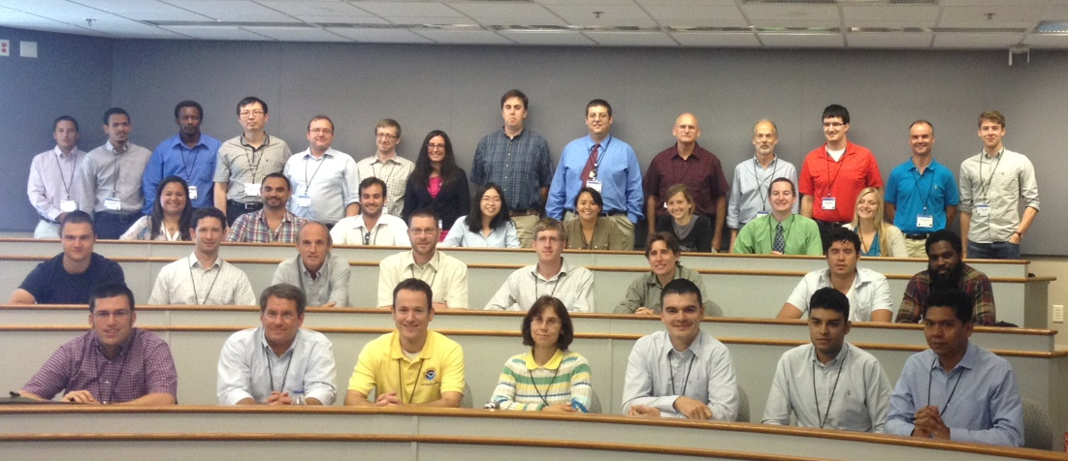
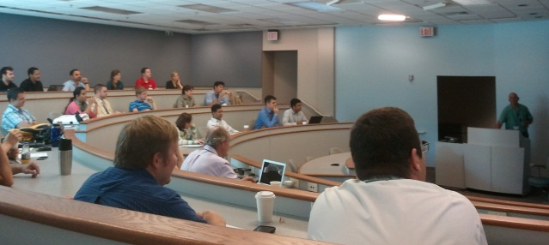
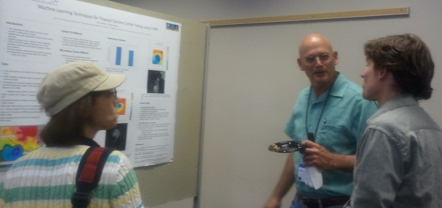
2013 CoRP Symposium
Scenes from the 2013 Cooperative Research Program Symposium at CIMSS
Notes:
The CoRP Network is supported by the NESDIS cooperative institutes: Cooperative Institute for Climate and Satellite (CICS, Maryland and North Carolina), Cooperative Institute for Oceanographic Satellite Studies (CIOSS), Cooperative Institute for Research in the Atmosphere (CIRA), Cooperative Remote Sensing Science and Technology Center (CREST), & CIMSS.

Slide 4
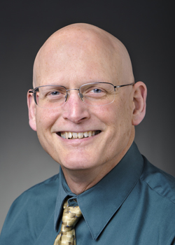
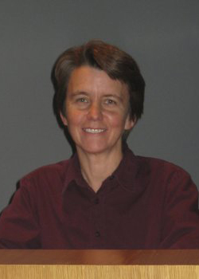
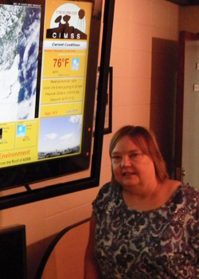
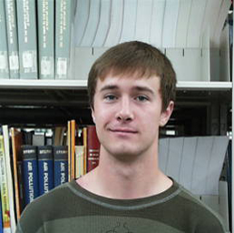
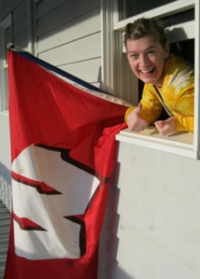
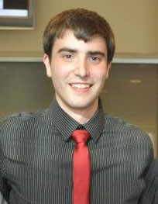
CIMSS EPO
2014 AMS Fellow!
Steve Ackerman
- CIMSS Director
- AOS Professor
- Associate Dean
- Weather Guys
(radio & print)
- AMS Teaching Award
- NASA Exceptional Public
Service Medal
Margaret Mooney
- CIMSS EPO Director
- Former NWS MIC
- Certified Globe Trainer
- NOAA Climate Steward
- ESIP Education co-chair
Maria Vasys
- Outreach Specialist
- Conference Organizer
- “Everything” Organizer!
Hayden Klabunde
- Graphic Artist
- Data Visualization
CURRENT STUDENT INTERNS
Britta Gjermo (left)
& Andrew Winters (right)

Slide 5
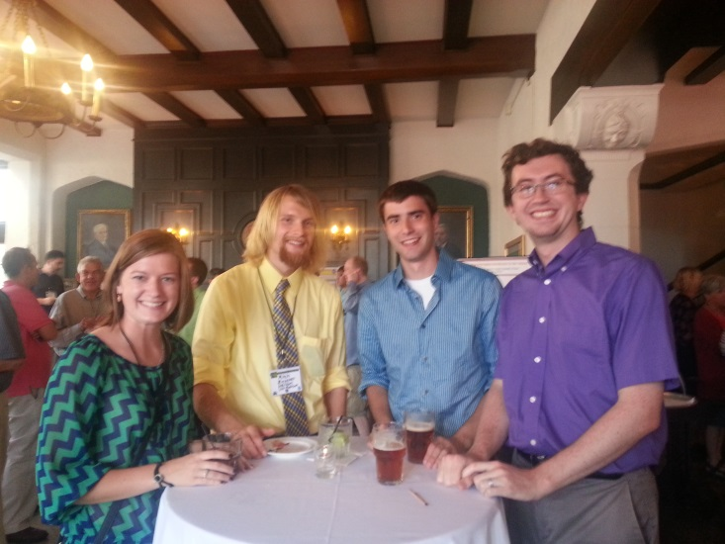
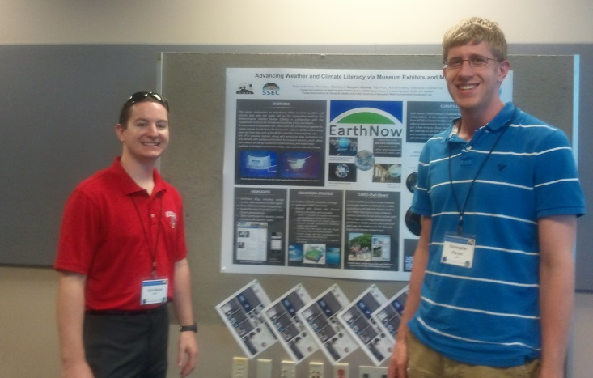
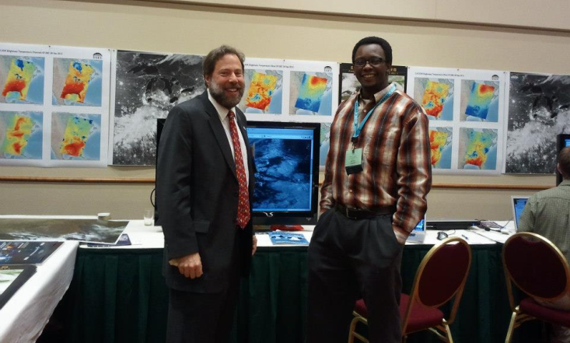
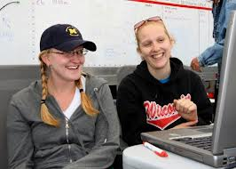
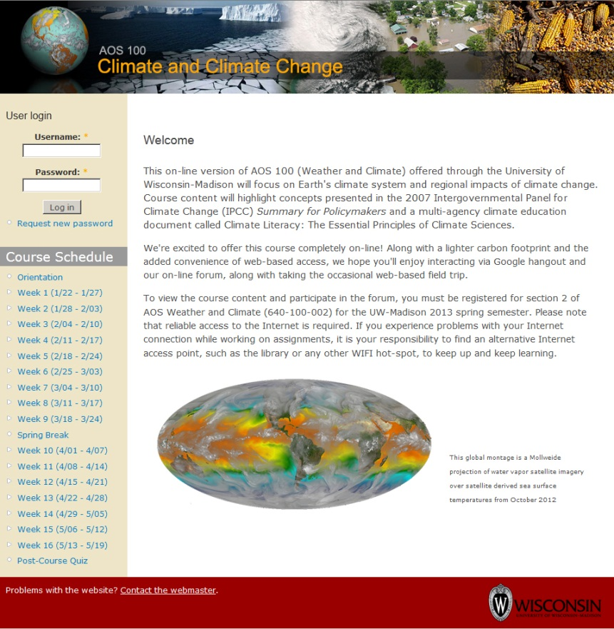
Grad Student EPO Activities
The Key is GETTING INVOLVED
2013 CoRP Symposium
2014 Satellites & Education Conference
2013 NWA meeting
2013 Field Experiment

Slide 6
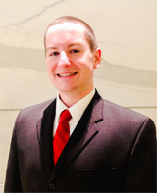
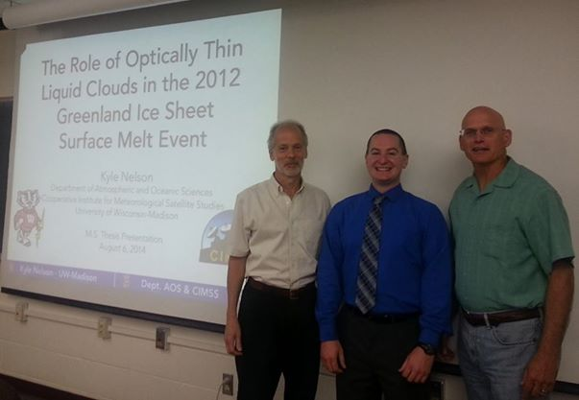
Student Profiles: Kyle Nelson
-Volunteered for 2013 CIMSS Student Workshop
- Presented at 2013 CoRP Symposium
- Applied (& was awarded) ESIP Student Fellow
- Volunteered at ALNC SOS exhibit
- Worked for CIMSS May-August 2014
- Earned an ESIP FUNding Friday grant

Slide 7
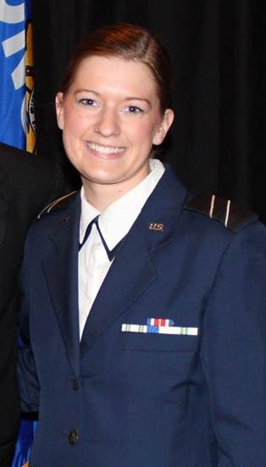
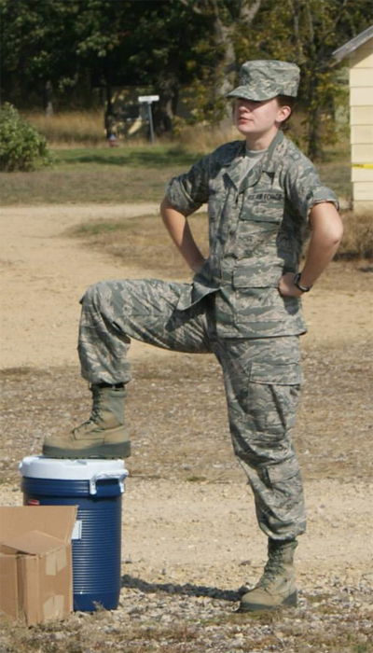
Student Profiles: Britta Gjermo
- Awarded Suomi Scholarship in High School
- Began working at CIMSS in her freshman year of Undergraduate
- Air Force ROTC
- Contributes to CIMSS PyroCB blog
- Taking lead on CIMSS social media
- Contributes narration for the
monthly Climate Digest product
Notes:
Britta Gjermo is a 2nd year senior at UW-Madison majoring in Atmospheric Science. She is also in Air Force ROTC and will commission as a Weather Officer upon graduation. Growing up in Minnesota, Britta experienced extreme weather year-round, from snow storms in January to thunderstorms in June, and quickly became fascinated by weather phenomena. After winning a Suomi Scholarship, Britta started working at CIMSS her freshman year, where she contributed to Satellites See Wisconsin, a display at the Dane County Airport. She regularly supports building tours and conferences at CIMSS and SSEC, especially the annual CIMSS Student Workshop. Britta recently started contributing to the CIMSS PyroCB blog, CIMSS social media, and the monthly Climate Digest product.

Slide 8
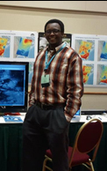
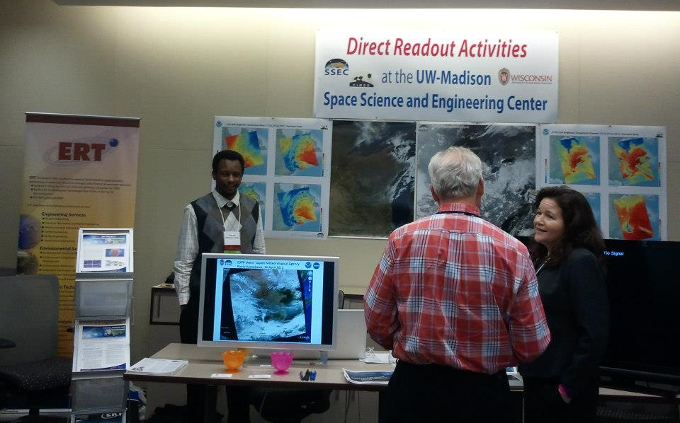
Student Profiles: Kaba Bah
Routinely volunteers to staff CIMSS Booths
Presents at CIMSS Outreach events
Conducts cutting-edge Air Quality research

Slide 9
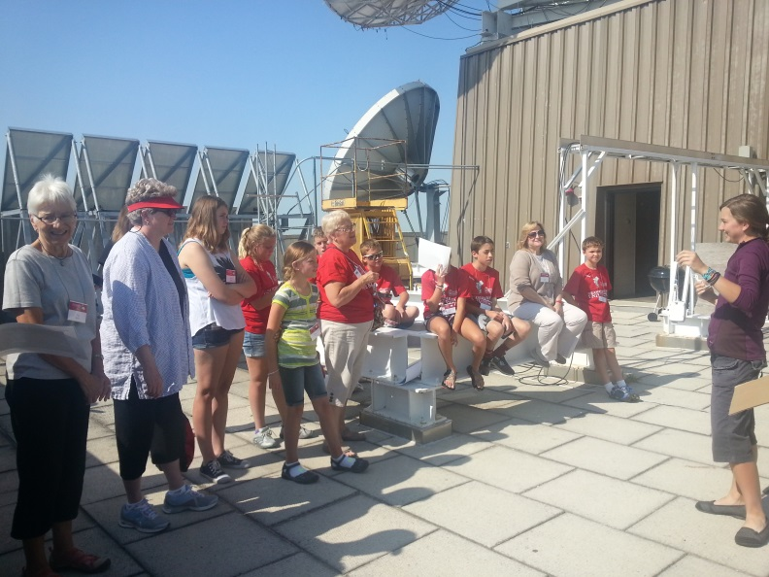
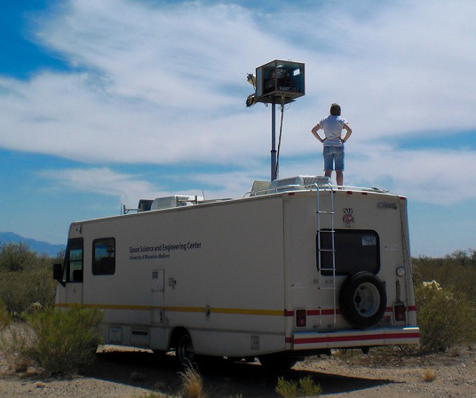
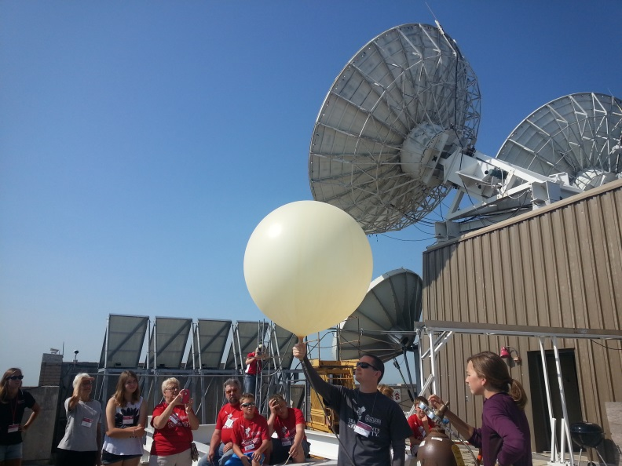
Student Profiles: Michelle Feltz
Conducts balloon launches at outreach events and explains the science
Lead author on research published in the Journal of Geophysical Research

Slide 10
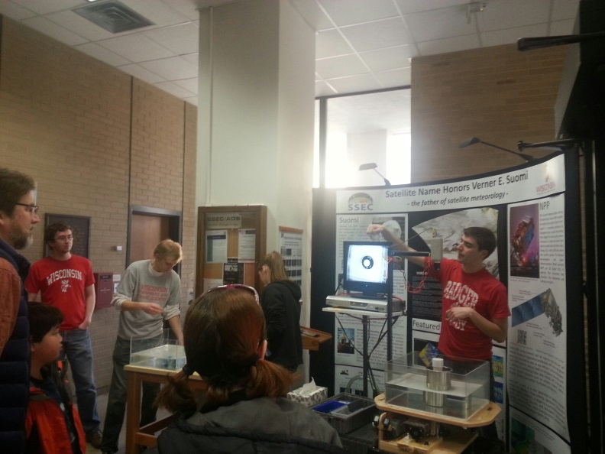
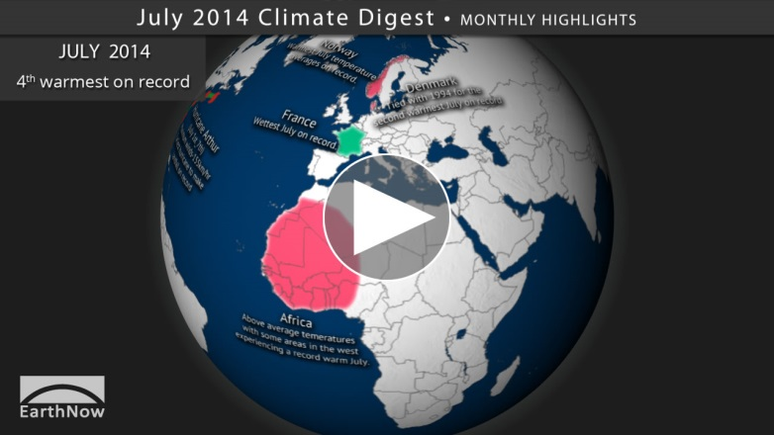
Student Profiles: Andrew Winters
Volunteers at ALNC SOS
Participates in building-wide outreach events
Presents at CIMSS Student Workshop
Contributes narration for the Climate Digest Product
Notes:
Besides performing research, Andrew is extremely interested in communicating the science, especially to new audiences via teaching or outreach. At CIMSS, this includes recording narration for the monthly Climate Digest product and presenting in the CIMSS Student Workshop.

Slide 11
Grad Student Opportunities
ESIP Fellows (applications due Oct. 8th)
The Federation of Earth Science Information Partners (ESIP)
is a national organization supported by NOAA that offers
Unique fellowships to graduate and post-doc students.
CoRP Student Exchange (make connections this week!)
The Early Career Scientist Exchange Program is an research
training and education initiative by NESDIS/STAR' Cooperative
Research Program [CoRP] initiated in 2006 where students from
NESDIS Cooperative Institutes can visit other CIs.
Notes:
The Early Career Scientist Exchange Program is an research training and education initiative by NESDIS/STAR' Cooperative Research Program [CoRP] which was initiated in year 2006. Students from CREST and other NESDIS Cooperative Institutes [CIs] are given an opportunity to visit intuitional PIs/Scientists from one of these CIs to learn software skills and gain hands-on research experience relevant to their doctoral research. Thirty CREST graduate students have been immensely benefited by this program.
Purpose of the program:
Within the NOAA/NESDIS/STAR Cooperative Research Program (CoRP), several activities are supported that address two goals: (1) Increased visibility and employment opportunities for students and early career scientists (and provide the best candidates for open positions in NOAA and the CI’s); and (2) Strengthened collaborations between CI personnel at all levels. To accomplish these goals, CoRP supports:
The STAR/CoRP Science Symposium, held each summer at one CI. Travel funds are available for students and early career scientists to attend.
Scientific exchanges for students and early career scientists, for visits to other CI’s during which the student will give a seminar and interact with research scientists located at other CI’s.
Scientific exchanges for established CI research scientists to visit other CI’s and early career scientists and undergraduate students, present their most exciting research results and develop or strengthen scientific partnerships.
Each CI receives a small amount of annual funding from NOAA/NESDIS/CoRP to send their students and research scientists to the CoRP Symposium and/or to other CI locations to present seminars and interact with the scientists at that institution. The scientific exchanges for students and early career scientists (visits to other CI’s to strengthen or establish collaborations) require the most preparation and coordination by all parties. A suggested procedure is given below. These exchanges may occur at any time during the year as long as the student and PI are in agreement; however, most exchanges are preferable during the summer.
Outcomes of the exchanges are expected to include: continuing collaboration between the student/PI/CI; a detailed report from the student of the exchange program; and (possibly) a presentation at the next year's CoRP Symposium and/or a seminar at STAR Headquarters or the host CI.

Slide 12
ESIP Student Fellows
ESIP is currently accepting applications for fellows in:
Agriculture & Climate
Data Stewardship
Disaster Life Cycle
Documentation
Drupal
Energy & Climate
EnviroSensing
Science Software
Semantic Web
Details:
Title: ESIP Student Fellowship Stipend: $2000/year + Travel to two ESIP Meetings Location: Virtual, 2 physical meetings (Washington, D.C. in Jan and at an ESIP member-location in July) Contact: Erin Robinson (erinrobinson@esipfed.org) Deadline: Application due October 8, 2014 Application Link: http://esipfed.org/node/1778
# of awards: 5-6

Slide 13
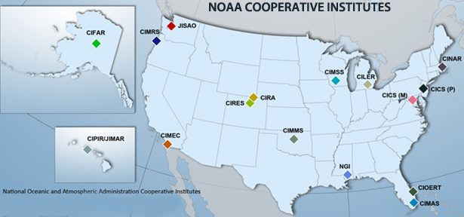
CoRP Student Exchange
Students from NESDIS Cooperative Institutes can visit PIs/Scientists from another CI to gain hands-on research and relevant EPO experience!
NESDIS CIs
CIMSS
CICS
-MD
-NC
CIRA
CREST
-CUNY
-Los Angeles
-Puerto Rico
Notes:
The Early Career Scientist Exchange Program is an research training and education initiative by NESDIS/STAR' Cooperative Research Program [CoRP] which was initiated in year 2006. Students from CREST and other NESDIS Cooperative Institutes [CIs] are given an opportunity to visit instutional PIs/Scientists from one of these CIs to learn software skills and gain hands-on research experience relevant to their doctoral research. Thirty CREST graduate students have been immensely benefited by this program.
Purpose of the program:
Within the NOAA/NESDIS/STAR Cooperative Research Program (CoRP), several activities are supported that address two goals: (1) Increased visibility and employment opportunities for students and early career scientists (and provide the best candidates for open positions in NOAA and the CI’s); and (2) Strengthened collaborations between CI personnel at all levels. To accomplish these goals, CoRP supports:
The STAR/CoRP Science Symposium, held each summer at one CI. Travel funds are available for students and early career scientists to attend.
Scientific exchanges for students and early career scientists, for visits to other CI’s during which the student will give a seminar and interact with research scientists located at other CI’s.
Scientific exchanges for established CI research scientists to visit other CI’s and early career scientists and undergraduate students, present their most exciting research results and develop or strengthen scientific partnerships.
Each CI receives a small amount of annual funding from NOAA/NESDIS/CoRP to send their students and research scientists to the CoRP Symposium and/or to other CI locations to present seminars and interact with the scientists at that institution. The scientific exchanges for students and early career scientists (visits to other CI’s to strengthen or establish collaborations) require the most preparation and coordination by all parties. A suggested procedure is given below. These exchanges may occur at any time during the year as long as the student and PI are in agreement; however, most exchanges are preferable during the summer.
Outcomes of the exchanges are expected to include: continuing collaboration between the student/PI/CI; a detailed report from the student of the exchange program; and (possibly) a presentation at the next year's CoRP Symposium and/or a seminar at STAR Headquarters or the host CI.

Slide 14
CoRP Student Exchange
Exchanges may occur at any time during the year, however, most occur over the summer.
Outcomes include:
- continuing collaboration between the student/PI/CI;
-detailed report by the exchange student;
- a seminar at the host CI, STAR Headquarters, or a presentation at the next year's CoRP Symposium!

Slide 15
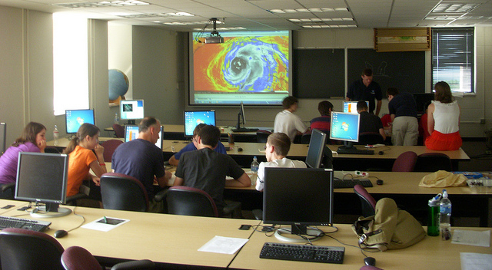
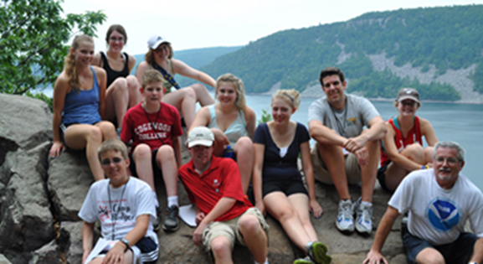
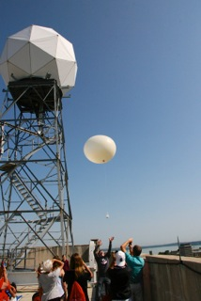
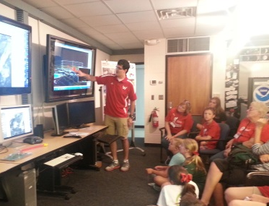
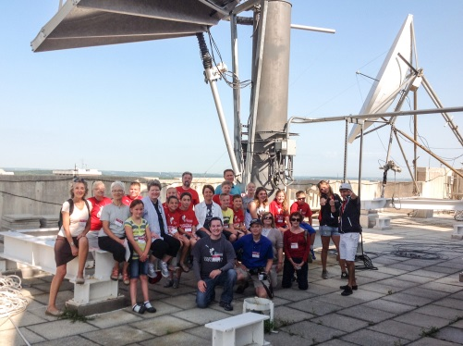
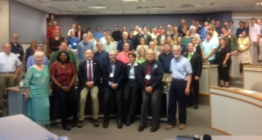
CIMSS Summer EPO Activities
High School Student Workshop
Grandparents University (GPU)
Educators Initiatives

Slide 16
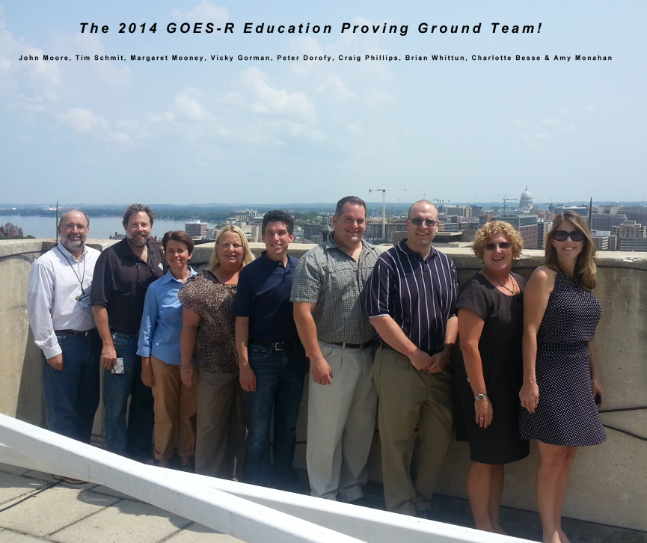
GOES-R Education Proving Ground
The design and development of lesson plans and activities for G6-12 teachers & students by a core group of educators working with CIMSS EPO and NOAA scientists at ASPB at CIMSS.
Our goal is to prepare the
education community to
be launch ready for new
satellite imagery and
improved products that
will be available in the
upcoming GOES-R era.

Slide 17
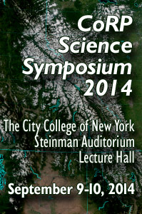
In Summary – Get Connected!
Identify people and topics you’re passionate about at this 2014 CoRP Symposium and find ways to collaborate !
QUESTIONS or COMMENTS?
You can reach me at margaret.mooney@ssec.wisc.edu

